Slide 1
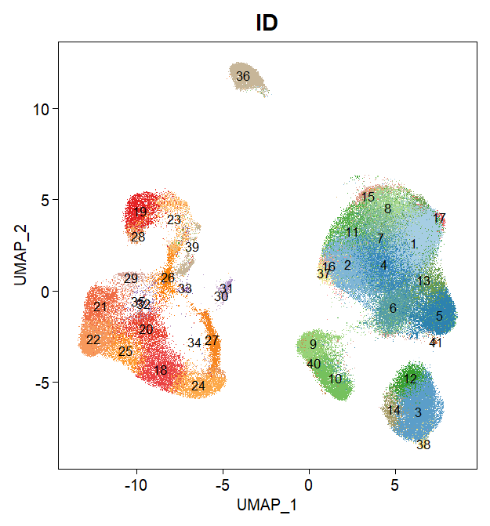
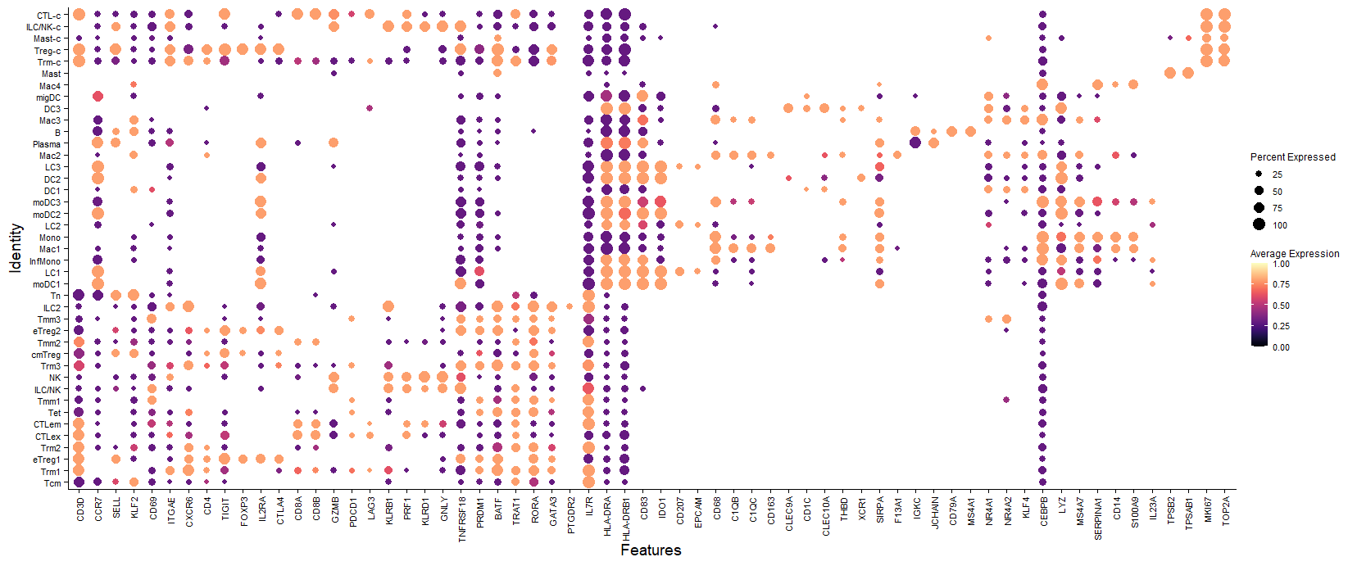
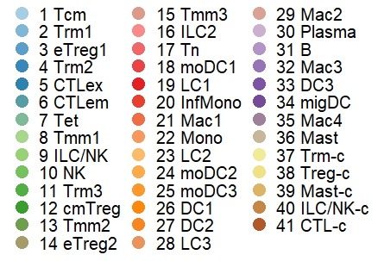
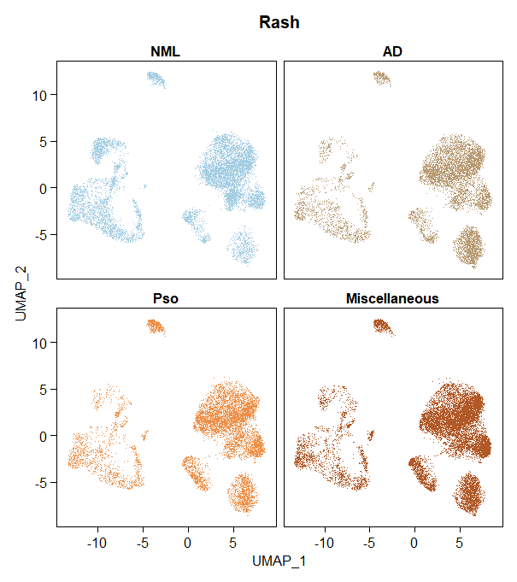
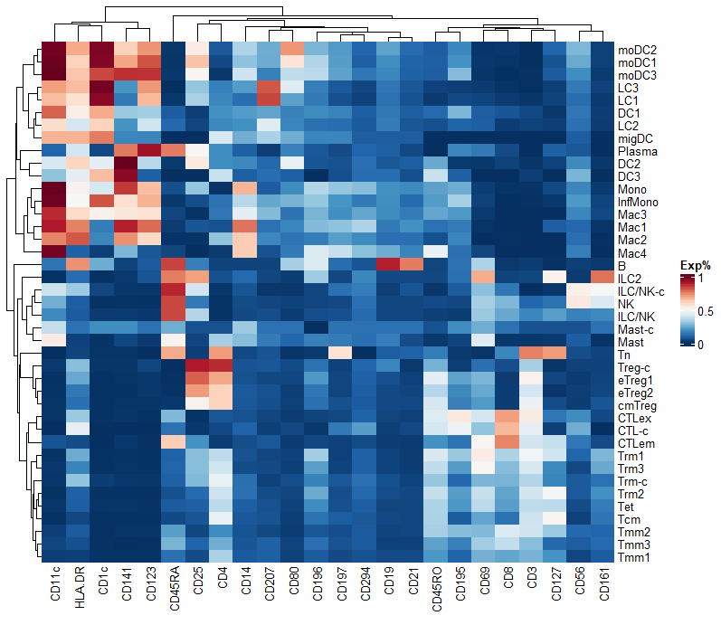
A
C
B
D
Notes:
Rachel:
Panel b: change Pso to PV panel c: Gene names on x-axis to italics
change Percent Expressed to Percent Expressing
Panel d. Flip labels on y-axis to left and dendrogram to right
remove Exp% from key on Right
Please adjust sizing and arrangement to make panel C fit better and be as large as possible

